Slide 1
Brovsi Fraud Risk Data ANALYSIS
By: Ranon Sim

Slide 2
Mission To expand the WSA programme globally
Objective
Identify any improvements to the current WSA claims system before it can be pushed out globally
Improvements in terms of data collection
Improvements to the current internal controls and policies relating to claims.
Analysis
Basic statistical measures and findings from analysis of dataset variables
Effectiveness of internal controls based on preliminary analysis
Machine learning findings based on risk analysis
Expected outcomes and recommendations
Shortcomings
Understanding of metadata
Domain Knowledge

Slide 3
Preliminary analysis
Assumptions made:
WSA policy on Max. Amount claimable are per annum
RCPT_DT refers to the date a welfare benefit becomes claimable
CLM_DT refers to the actual date the claim gets submitted by the employee
Individuals can make multiple claims of the same category and will not violate rules as long as the sum of the claims per category are < Max. Allowable Claim Limit specified (500,100,30)
All claim categories can be made anytime within the year (including birthday claims) -> Can consider revising this for BIRT claims to reduce #claims to transact
Dataset A and B are in inversed order

Slide 4
Employees with most claims per category in two years
Claim Category | Employees (# claims)
# Flexi Claims | 3122 (32) , 6707 (29), 7420 (28), 6243 (27), 7713 (25) *Employees with most overall claims are also top in the Flexi Claims Category
# MIIS Claims | 4592 (18), 3371(12), 3419 (12), 2590(12)
# Birthday Claims | 6280 (22), 3957 (18), 10197(17), 4734 (16), 8843 (16)
# Overall Claims | 6243 | 44
 | 7713 | 38
 | 3122 | 34
 | 6707 | 31
 | 7420 | 31

Slide 5
Violations to WSA Claims Policy
 | Claim Submission Duration |  | Reimbursement Duration
(Potential anomalies) | <1 days | >31 days | <30 days | >60 days
# Claims | - | 3484 | 3612 | -
# Employees | - | 3002 out of 7695 (~39%) | 3612 out of 7695 (~47%) | -
Top 5 Employees who violated policy |  | 3478, 4234, 11208, 3212, 4483 (4 claims) | 9648, 9920, 6498, 4363, 7521, 5248, 8365, 2221 (4 claims)

Slide 6
Violations to Maximum Allowable Claim Amount (Per year)
Claim Category | FLXI (1-8) Max = 500 | MIIS Max = 300 | BIRT Max = 30
# Claims exceeding Maximum Claim Amount | 3183 | 32 | 1802
Top 5 Employees who violated policy | 6172, 9846, 8723, 1729, 2741 | 1633, 1856, 7881, 6878, 6153 | 8876, 5999, 7466, 8123, 10402

Slide 7
Claims without audit
13.9% (5109) of claims didn’t appear to be audited.
These unaudited claims all occur in 2018
Unaudited claims whose reimbursement date occur after the 2018 audit date (20/9/18) = 2888/5109 (56.5%)
Top unaudited Flexi benefit subcategory = Welness (586 claims)

Slide 8
Risk analysis
Objectives
Further exploratory analysis findings with fraudulent labels
Machine Learning Implementation & Results

Slide 9
Are there any particular Category of benefits has a higher risk of fraud
No particular WSA_TYP category has a particularly high risk.
No particular FLEXBEN_TYPE category within FLEXIBLE benefits has a particularly high risk
Highest was 8.0 (Prof. Membership Fees) followed by 6.0 (Personal/Work Enrichment)

Slide 10
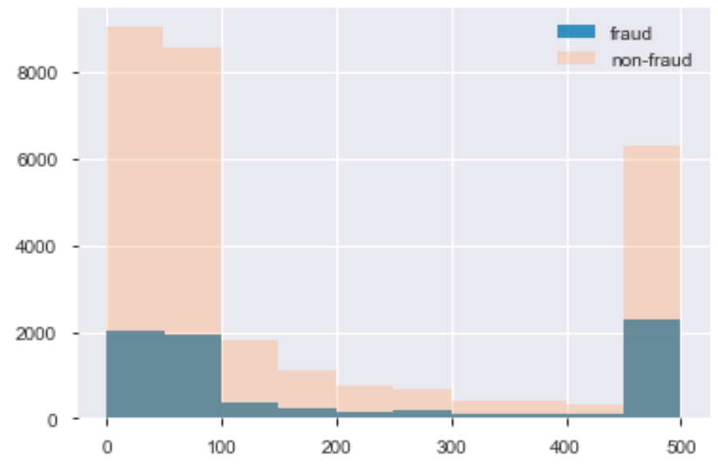
Fraudulent claims have a higher % of claims <=100

Slide 11
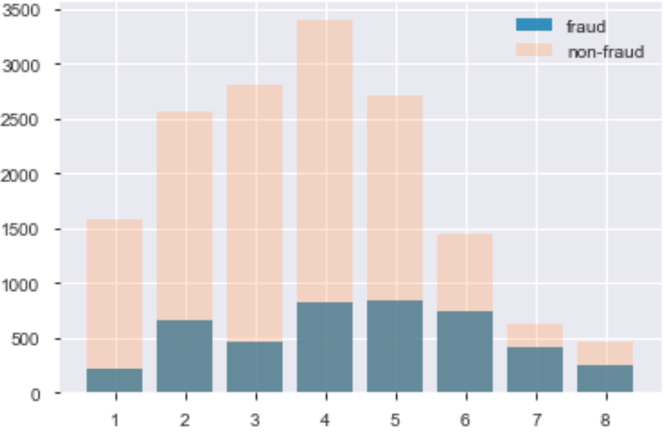
Top Flexi Sub-Categories for non-fraud = 3,4,5 Top Flexi Sub-Categories for fraud = 4,5,6

Slide 12
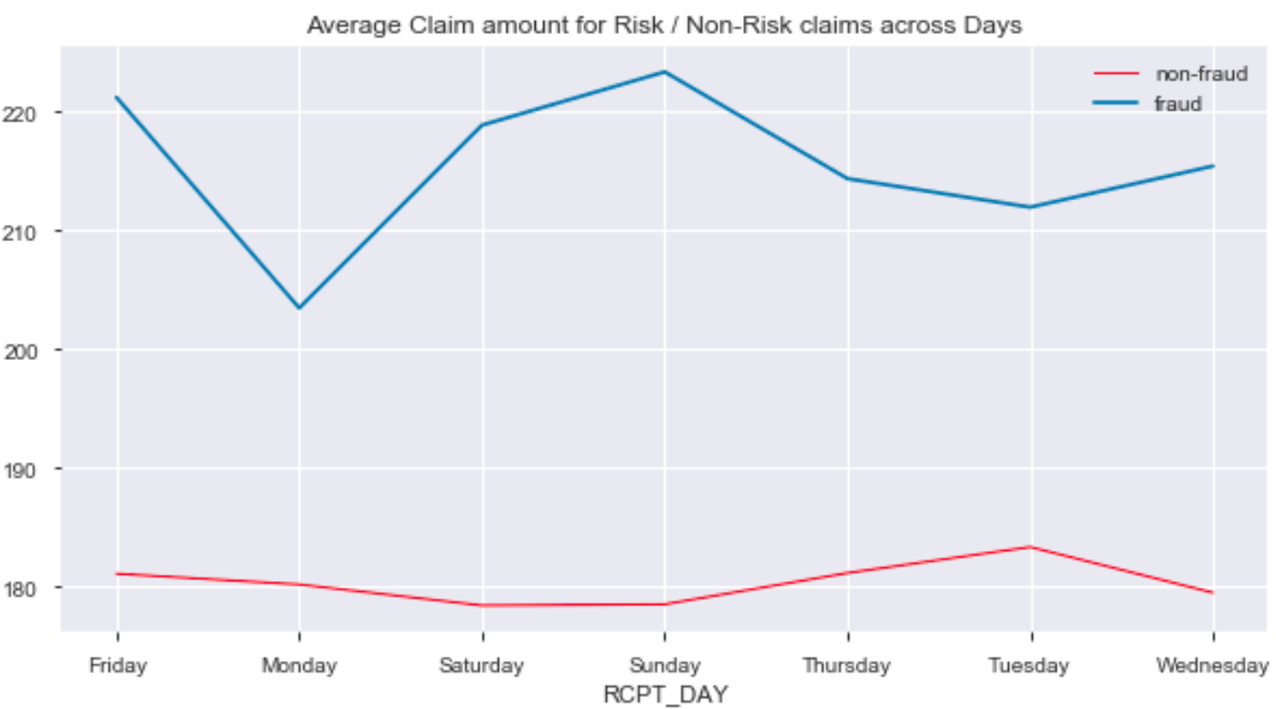
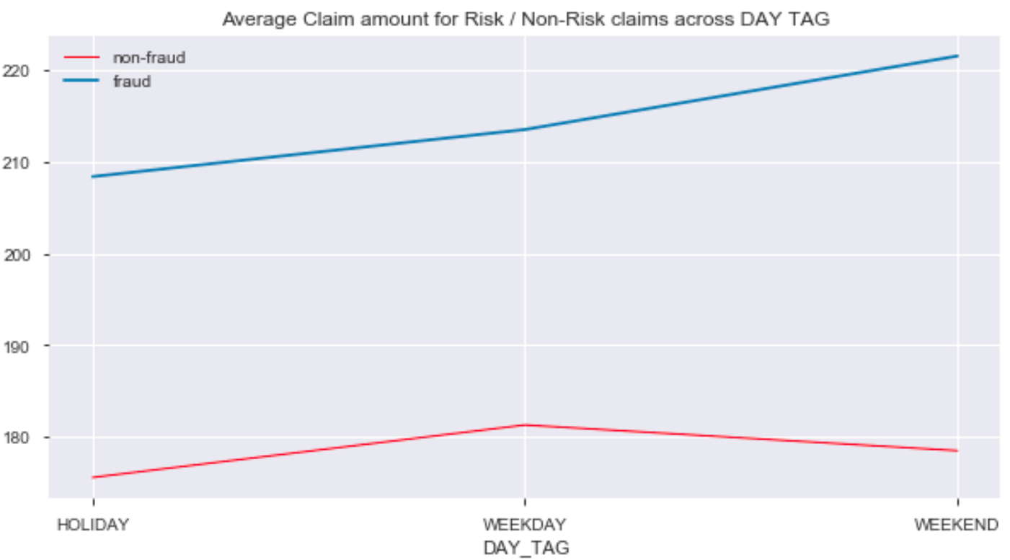
Average claim amounts vary across time for fraud / non-fraud cases
Fraud cases
Non-Fraud cases
Average Claim Amt is higher for Fraud cases
Average Claim Amt is higher on Wkends
Average Claim Amt spikes on Sundays and dips on Mondays
Average Claim Amt is lower for non-fraud cases
Average Claim Amt is higher on Wkdays
Avg Claim Amt remains below 190 and is highest on Tuesdays

Slide 13
Risk Analysis Pipeline
Data Generation
Import Data
Data Cleaning
Data Scaling / Normalization
Normalized Data
Insights Generation
Data Exploration
Feature Selection + Exploration
Correlation Analysis
Features
Features + Normalized Data
Logistic Regression/Random Forest Classifier
Ensemble Models
Risk Prediction
Evaluation Generation
Evaluation
Evaluation

Slide 14
Data Cleaning/PREPARATION
Data Cleaning Steps
Removal of variables that are IDs and columns with only 1 value Impute NA values for (FLEXBEN_TYPE) with 0.0 Standardize columns that are highly skewed (like CLM_AMT) Scaling of data before implementing distance-based algorithms like K-Means clustering

Slide 15
Feature engineering
Features Engineered
Creating of “days_before_claim_submission” and “days_before_reimbursement” columns Dummifying of categorical (including those masked as numeric values)

Slide 16
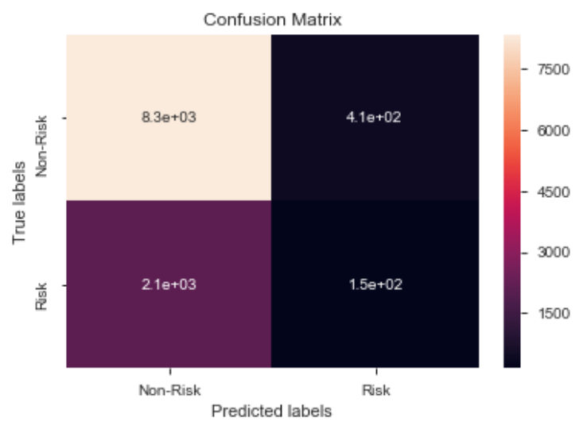

UNSUPERVISED Machine Learning techniques
Models Used | Purpose | Technique
K-Means Clustering | Identifying fraud through outliers (based on distance to centroid) | The top 5th percentile of claims that are furthest away from the cluster centroids are defined as outliers. These represent potential fraudulent cases
Results reveal a low number of true positives using K-Means clustering (146)

Slide 17
Ensemble method provides the best overall True positive predictions
Machine Learning Model Results
Claim Category | Logistic Regression | Random Forest Classifier | Ensemble method (4 models)
ROC | 0.70 | 0.71 | 0.71
Accuracy | 0.86 | 0.868 | 0.87
F1-Score (True Positives) | 0.55 | 0.58 | 0.58
Precision (True Positives) | 0.78 | 0.79 | 0.45
Recall (True Positives) | 0.43 | 0.46 | 0.81

Slide 18
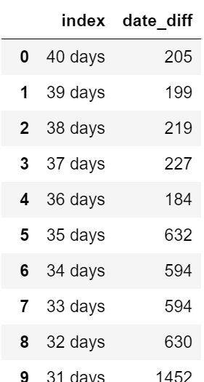
Recommendations on policy
Consider restricting the number of claims made within a year to reduce chances of abuse / administrative checks.
Employee 6243 appears suspect due to the high number of claims made. However, none of his purchases exceed the Maximum Claimable Amount per category
Give Employees a flat out $30 rate for Birthday Category so they won’t abuse the system and try to make >1 claim or claim > limit
Come up with an exception report for the following:
Instances of Late Claim Submission > 31 days
Instances of Late Reimbursement (>60 days)
Instances of early Reimbursement (<30 days)
Instances where Employee exceed Maximum amount for each of the Claim Categories

Slide 19
Recommendations based machine learning results
Further parameter tuning is required to obtain better results from the models
Models can also be improved in the future with more features provided e.g. employee profile data
Since True positives are important for fraud detection of claims, we should make use of the F1-Score to assess the models rather than just the accuracy score
Based on the preliminary risk analysis, we should try to make use of theEnsemble Model Technique for predictions.

Slide 20
Shortcomings
Data/Metadata
Had to guess certain metadata meaning e.g. RCPT_DT / EA_DT
Dataset A and B are in inversed order
Lack of Employee data for Employee Profile Analysis

